Slide 1
Microvan Case
Julie Zhang, Mina Chen, Christopher Law,
Yuming Liang, Mohamed Mohsen
Group 10

Slide 2
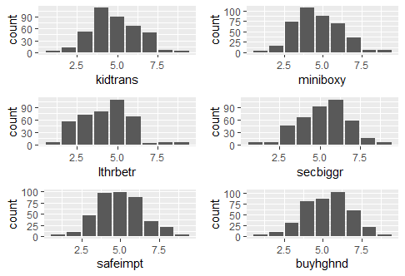
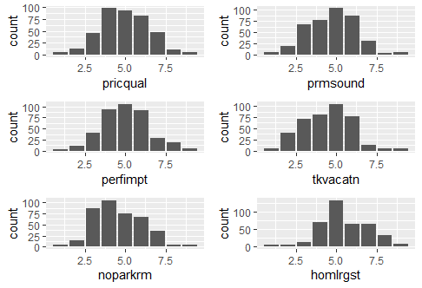
Exploratory Data Analysis (EDA)
Most of the distributions of the 30 variables resembled to normal distribution closely:
They have means around 5 (the center)
The curves are roughly symmetric at the center
Exceptions being the variable “carefmny” and “accesfun” of which distributions are less symmetric. But that was not much of a concern since majority of their values are within 2 to 6.

Slide 3
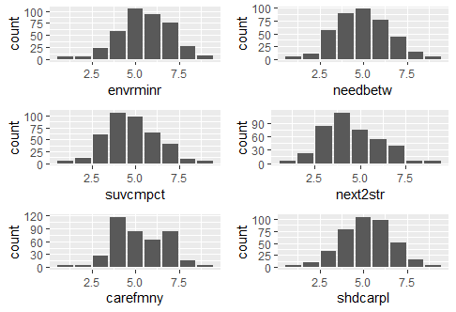
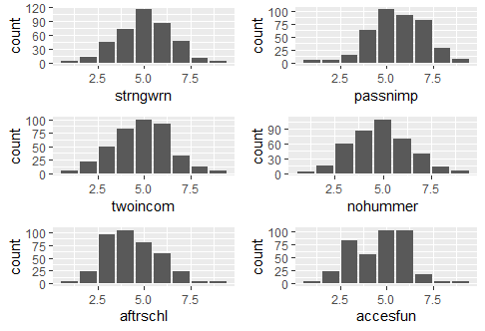
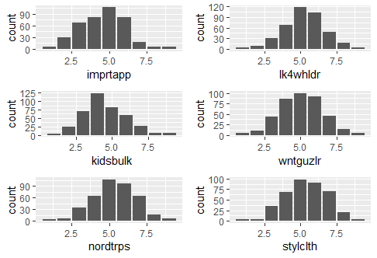
EDA
Neither did we find outliers by examining the histogram of variables.
We also took a closer look at the overall row mean and row sum. We did not find any respondent who showed no understanding of the survey.
Notes:
We then felt confident to proceed to creating a regression model using all the 30 variables.
R output:
> summary(data$sumall)
Min. 1st Qu. Median Mean 3rd Qu. Max.
118 138 148 148 157 178
> summary(data$mean)
Min. 1st Qu. Median Mean 3rd Qu. Max.
3.933 4.600 4.933 4.932 5.233 5.933

Slide 4
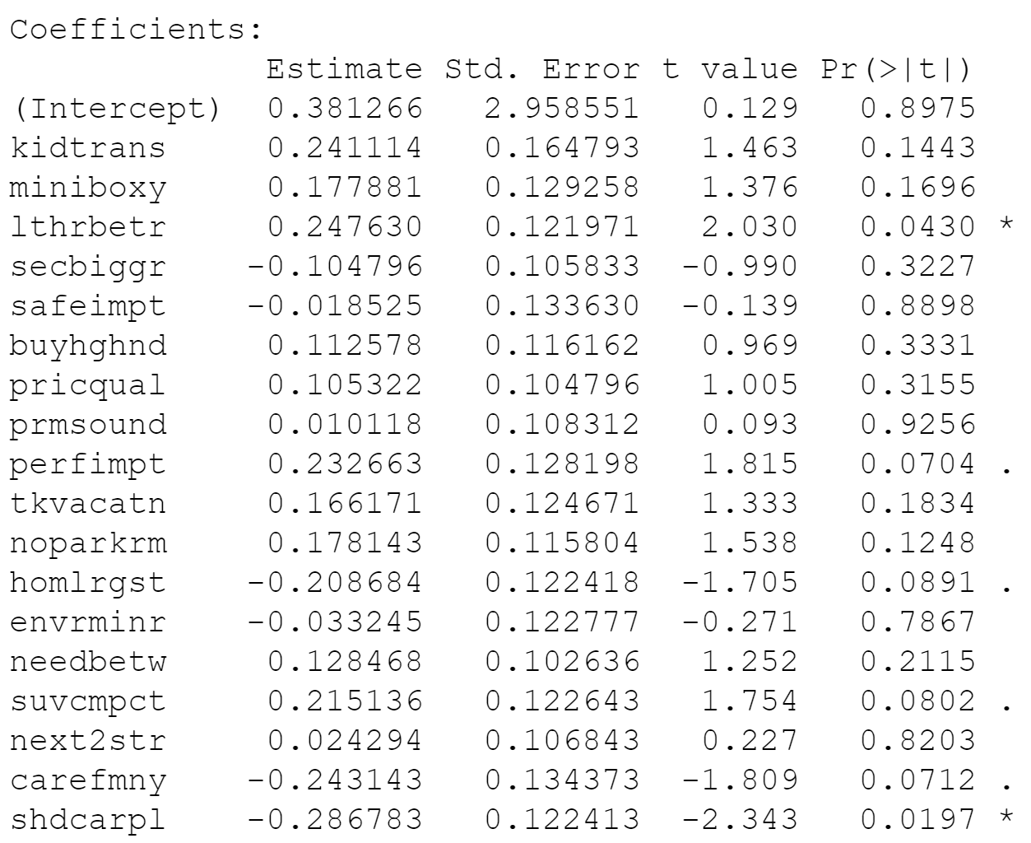
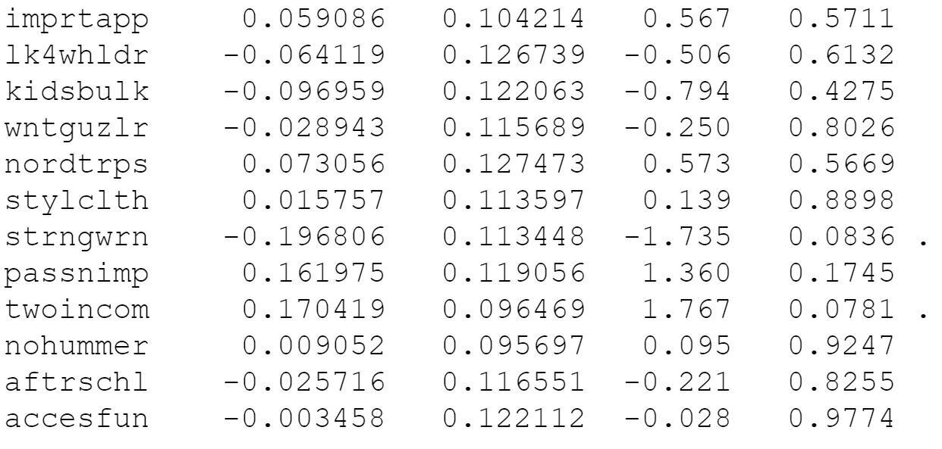
Full Model
All 400 records of 30 variables are in this full regression model.
In general, all signs on coefficients are making sense to a concept of microvan. In particular,
Signs that support concept of microvan in car size - nordtrps / suvcmpct/ needbetw / noparkrm / homlrgst
Signs of personality of the supporters of microvan - twoincom / imprtapp / stylclth / passnimp / carefmny
Signs that indicates uniqueness of microvan features - lthrbetr / buyhghnd / pricequal / prmsound
Only few exceptions that seems contradicting with the concept of microvan
secbiggr (negative) - likes wants bigger car
perfimpt (positive) - actually concerns power/ acceleration
kidsbulk (negative) - need bigger car to hold kid’s stuff
aftrschl (negative) - kids generally have more after-school activities
However, the important fact is, only too few (2) of these coefficients are statistically significant by p values. We will hope to conduct factor analysis to identify and take away any correlations between some of these variables and narrow down to a few factors for this study.
Notes:
Most of the variables are not significant -> Therefore, need to proceed to factor analysis.

Slide 5
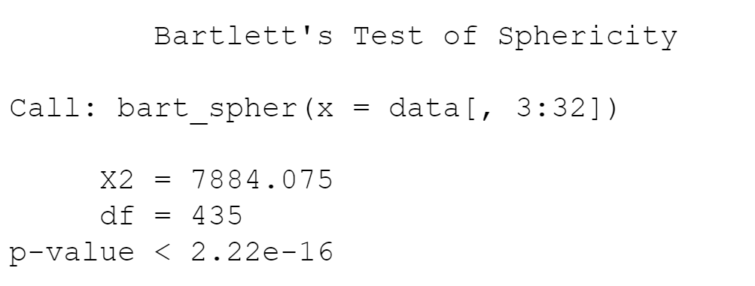
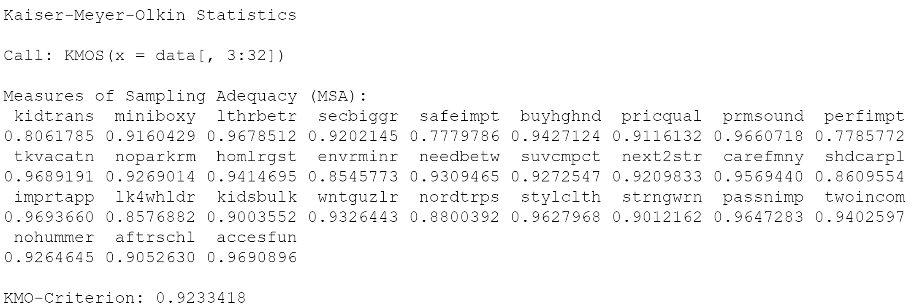
Factor Analysis - Evaluate Data
Bartlett’s Test of Sphericity: p-value<0.05
At least some of the variables have strong correlations, and thus correlation matrix is different from identity matrix.
KMO values are all above 0.6
The proportion of variance being common variance is low. Samples are adequate.
Conclusion: we can proceed to factor analysis.

Slide 6
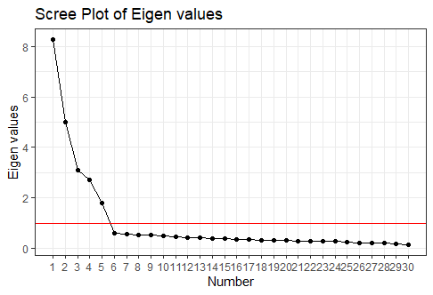
Factor Analysis - Eigen Values
5 factors have Eigen values > 1, so they convey more information than an individual variable.
We tried 6 factors as cutoffs. It turned out that the 6th factor has Eigen value of 0.63 and it’s only highly correlated with variable “nohummer”.
Therefore, we chose 5 as number of factors.

Slide 7
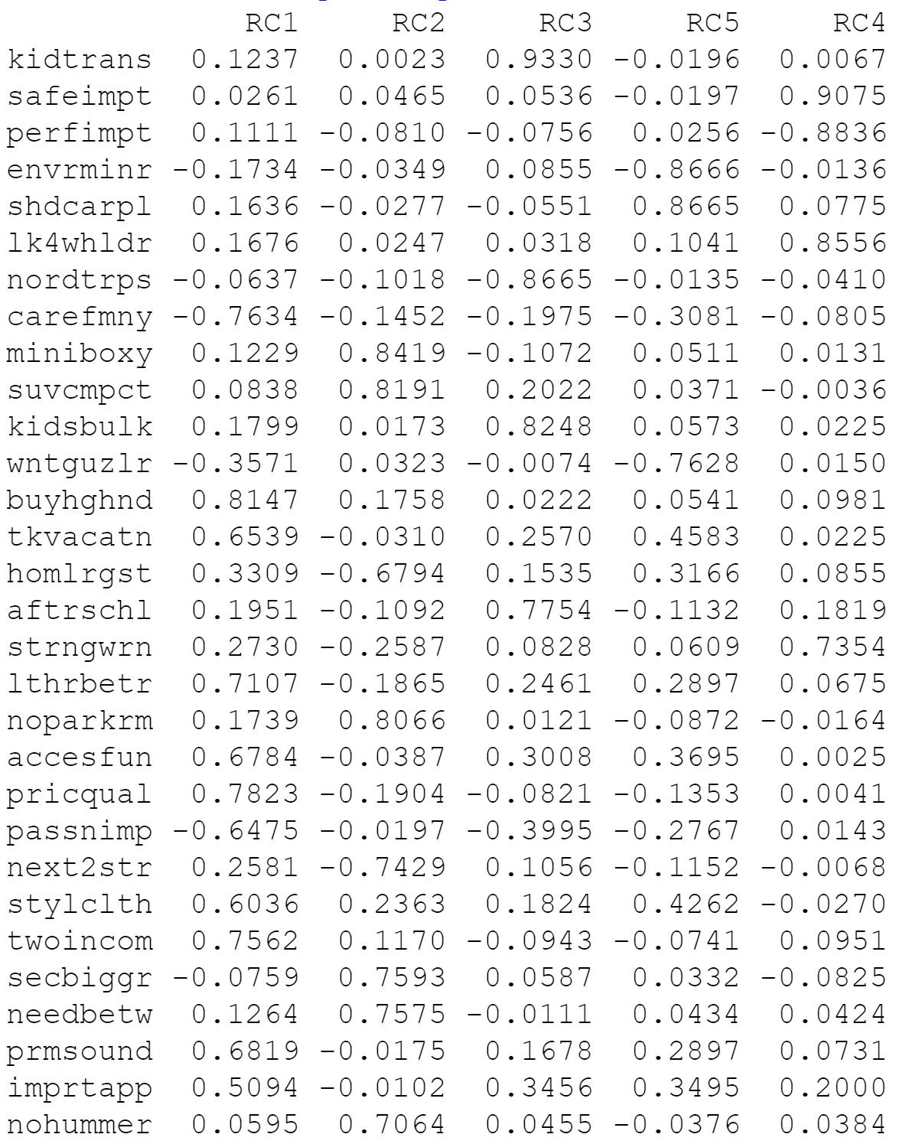
Factor Analysis - RC1
Factor 1 has high negative correlation with carefmny (Careful with money) and high positive correlation with buyghgnd (buy higher-end cars), pricqual (Car prices strongly reflect underlying production quality), lthrbetr (Leather seats are dramatically better than cloth), and twoincom (Our family would find it hard to subsist on just one income).
Factor 1 is related to price premium for quality.

Slide 8
Factor Analysis - RC2
Factor 2 has high negative correlation with next2str (Next car will be a two-seater) and high positive correlation with miniboxy (Current minivans are too boxy and large), suvcmpct (Like SUVs more than minivans since they're more compact), noparkrm (Current residence doesn't have a lot of parking room), secbiggr (Second car would need to be bigger than a standard sedan), needbetw (Needs to be something between a sedan and a minivan) and nohummer (Not interested in owning a vehicle like a Hummer)
Factor 2 is related to medium car size

Slide 9
Factor Analysis - RC3
Factor 3 has high negative correlation with nordtrps (We don‟t go on road trips with the family) and high positive correlation with kidtrans (We need a car that helps transport our kids and their friends), kidsbulk (Our kids tend to take a lot of bulky items and toys with them) and aftrschl (We engage in more after-school activities than most families)
Factor 3 is related to kids’ needs for vehicle.

Slide 10
Factor Analysis - RC4
Factor 4 has high negative correlation with perfimpt (Performance is very important in a car), and high positive correlation with safeimpt (Auto safety is very important to me), lk4whldr (Four-wheel drive is a very attractive option) and strngwrn (Warranty protection needs to be strong on a new car).
Factor 4 is related to safety

Slide 11
Factor Analysis - RC5
Factor 5 has high negative correlation with envrminr (The environmental impact of automobiles is relatively minor) and wntguzlr (Will buy what I want even if it is a “gas guzzler”), and high positive correlation with shdcarpl (Everyone should carpool or take public transportation).
Factor 5 is related to environmental impact.

Slide 12
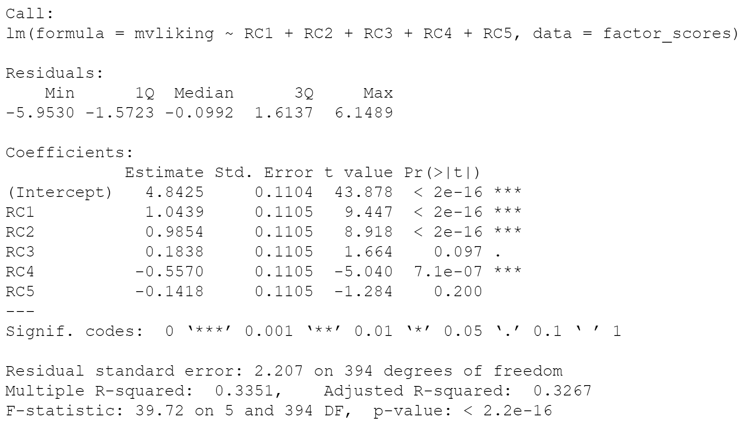
Regression using Factor Scores
For the factors regression model, the model fit, p-value, is the same as for the model using all the original predictors, as expected.
Two of the 5 factors (3 and 5) are insignificant. If we drop them and run the regression again using only factors 1, 2, and 4 we get a regression with all factors being significant.
Since the variability of the coefficient estimates are not greatly affected by the collinearity issue, the coefficient estimates are now larger than their respective standard errors compared to the original model with all the predictors.
Despite that the initial model (slide 4) fit is significant, there are too many predictors in the model and several of the coefficients are non-significant, indicating that these variables do not contribute much to the model.
Notes:
Compared to the first regression, this regression using factors has more significant terms.

Slide 13
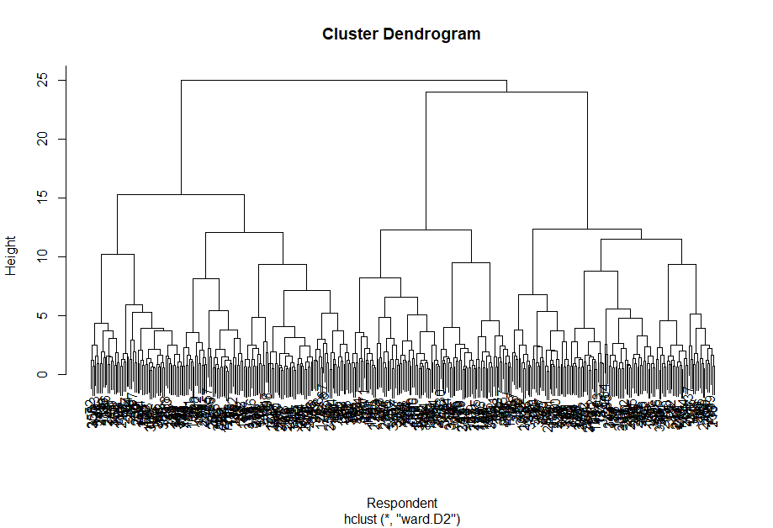
Market Segmentation - Hierarchical Cluster
The dendrogram shows that it is more appropriate to divide the respondents in the dataset into three clusters. Going lower down the hierarchy will be harder to manage.

Slide 14
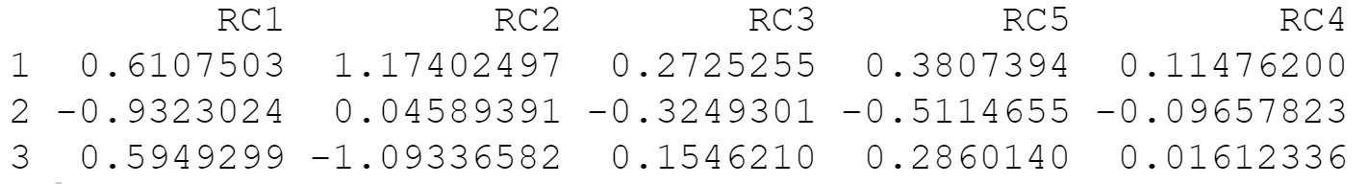
Market Segmentation - k-Means Clustering
Cluster Centers:
We will focus on 3 clusters for market positioning
Cluster | What Factor Scores They Differ | Label | Total Respondents
1 | Strong positive association with RC2 | Comfortable and spacious car lovers | 114
2 | Strong negative association with RC1 | Economical car buyers | 157
3 | Strong negative association with RC2 | Compact and mini car lovers | 129
Notes:
We found that 3 and 4 clusters are both manageable. 4 clusters may show more significance and insights of the difference among clusters.The 3 clusters make sense from the dendrogram and the k-means clustering results. Factor 1 and Factor 2 differentiate those 3 clusters. Cluster 2 and 3 have the opposite preference on the space requirement for a car.

Slide 15
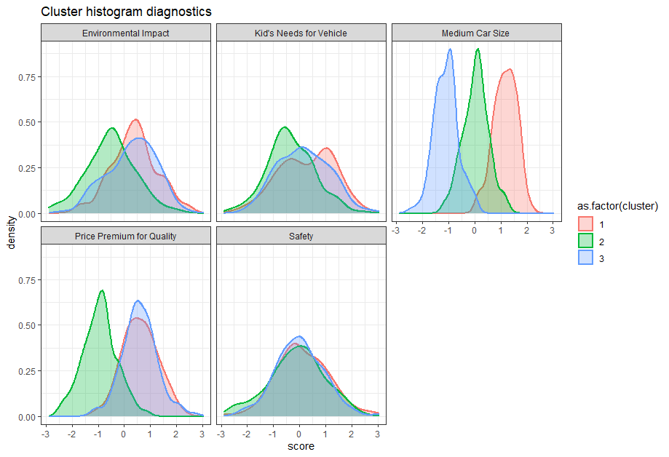
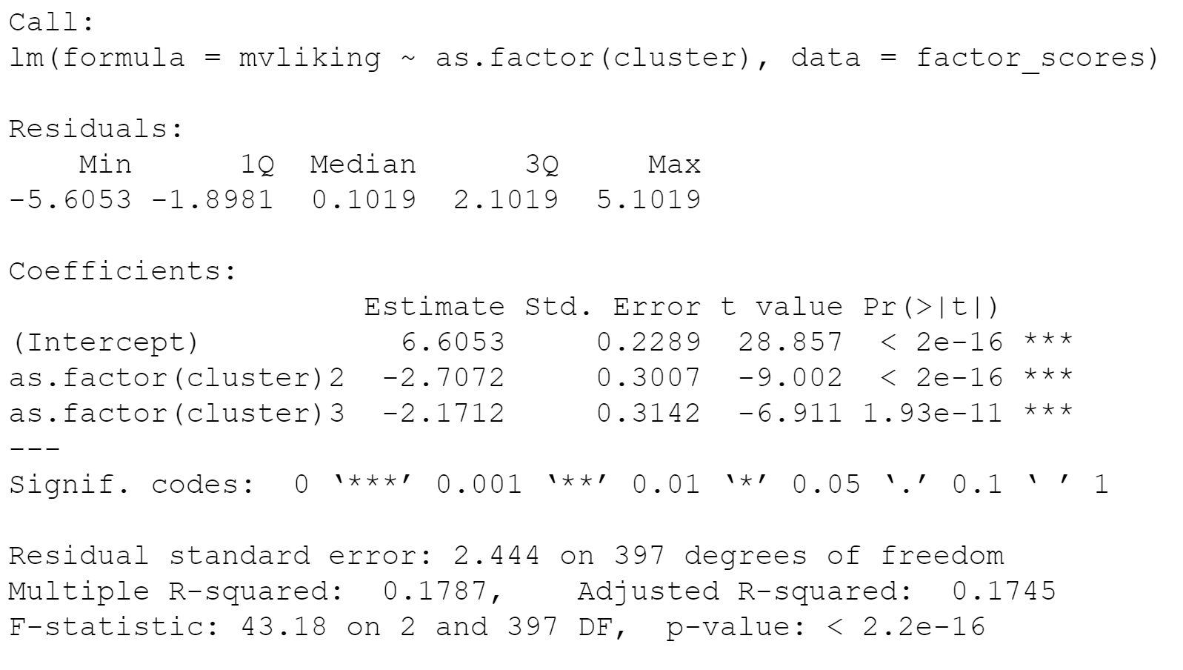
Concept Preference by Segments
Cluster Diagnostics on RC1-5 Regression of mvliking on cluster id
categorical variable
Notes:
On the left , cluster diagnostics histogram plotting illustrates graphically on the market segmentations we identified through K-means clustering
Cluster 1 has the highest means, and variation among the Medium Car Size factor.
Cluster 2 differentiates by it low means, at the Price Premium for Quality.
Cluster 3 indicates by its low mean in Medium Car Size factor, their contradicting preference with bigger-than-SUV Microvans.
Then on the right, by regression of good significance over cluster IDs and mvliking scores collected from the survey,
Cluster 1 mvliking score is significantly different from Cluster 2 and 3. This mean (intercept) mvliking score is on the pro side (6.6 out of 9 point scale) of microvan concept.
We will also look at cross tabulation to further support this observation.

Slide 16
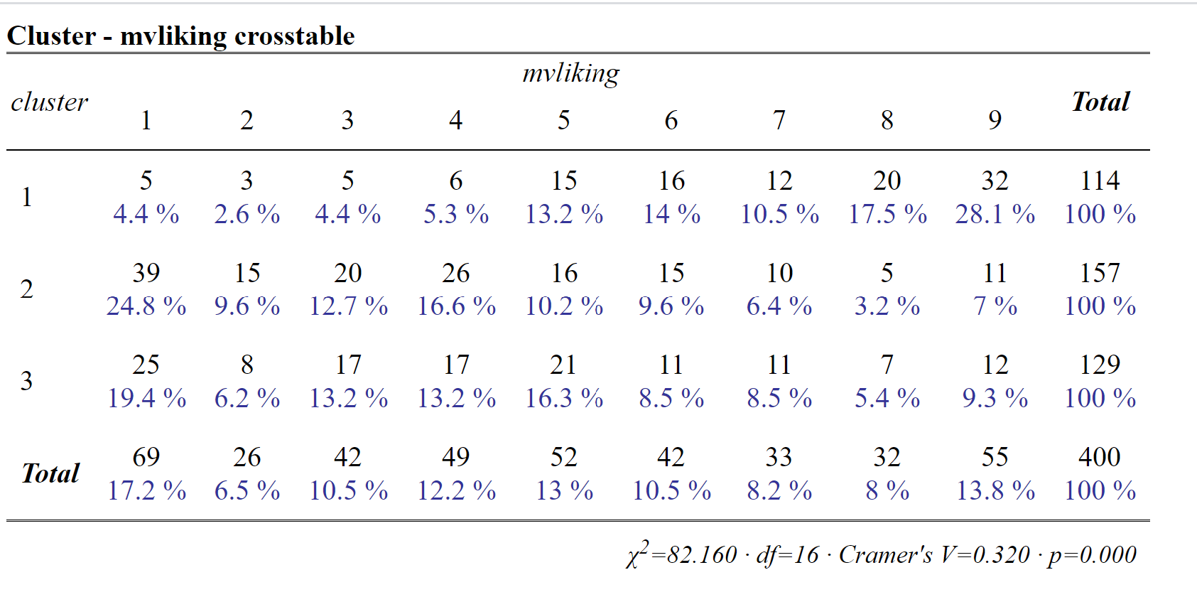
Cross tabulation of cluster membership and discrete
levels of mvliking
Notes:
Null hypothesis (H0): the clusters segment and the mvlikingle are independent.
Alternative hypothesis (H1): the clusters segment and the mvlikingle are dependent
The Chi-square statistic is calculated as follow: χ2=∑(o−e)2e, ( o is observed, e is expected)
This calculated Chi-square statistic is compared to the critical value (obtained from statistical tables) with df=(r−1)(c−1) degrees of freedom and p = 0.05.
Given that the Chi- square statistic of 82.160 is greater than the critical value of 26.296. We can conclude that cluster segment and mvliking is not independent and that they are significantly associated.

Slide 17
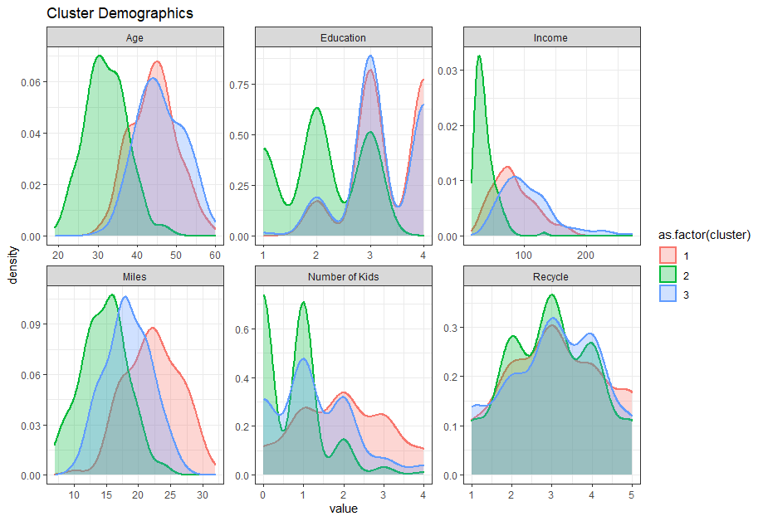
Demographic by Segments
Based on cluster centers, cluster 1 tends to value comfortable and spacious car. This is reasonable because they have the highest annual mileage driven, and they have an average of 2 children. This cluster also has relatively higher income.
The cluster centers in slide 14 show that cluster 2 values affordability. This is aligned with the demographic profile since majority of them have lower income. This cluster also tends to be younger. They drive the lowest mileage and mostly have 0 or 1 child.
Cluster 3 is the oldest among the three clusters, with the highest median income (see Appendix). Fifty-five percent of them are female, and they have an average of 1 child.
*Note: Summary table is available in Appendix.

Slide 18
Recommendations
We Recommend to Target on Cluster 1
From the results of regression and crosstab:
Cluster 1 has the highest liking score for microvans
From the results of factor analysis and clustering:
Cluster 1 has needs for bigger car space
From the results of demographics:
Cluster 1 has medium income level, high annual mileage, average of 2 kids
Positioning
Big (small to large family with kids) and durable (high average mileage per year)
Packed with features for kids - in-car AV system, cup holders, kids’ safety features, etc
Good high end visual quality, leather trim options must present
Medium and affordable price point
Notes:
Assuming the proportion of respondents in this study represent the proportion of the population, then cluster 1 is in a niche market rather than the biggest mass market of most people look for vehicles. We can highly focus on niche features to address this niche market.

Slide 19
Assumptions and Limitations
Assumptions:
We assume the GPA wants the most cost-saving and manageable segmentation, so we did analysis for 3 clusters instead of 4
Limitations:
The study did not consider how much respondents are willing to pay for a microvan
4 clusters would be better in more granularly targeting the customers
Small sample size can be a concern since the usable dataset consists only 400 observations
Next Steps:
Conduct conjoint study to test different price points
Analyze competitors and determine precise marketing position
Draft marketing mix strategies (4Ps)

Slide 20
Research Design Improvement
There are other customer data we want to collect to better target at and position on microvan, including:
Preference on electric, hybrid or gas fuel: to include more specific environment features that customers care
Perception on more car types such as hatchback, pick-up trucks: to understand what features the customers desire from each car type
Create perceptual map and use the “white space”: to discover new customer segmentations
Budget and buying intent: to finalize price tiers and design more reasonable add-on packages
Notes:
If you were to design the descriptive research for the case, how would to do it differently? Are there any other data you would like to collect and how would you use them?

Slide 21
Appendix

Slide 22
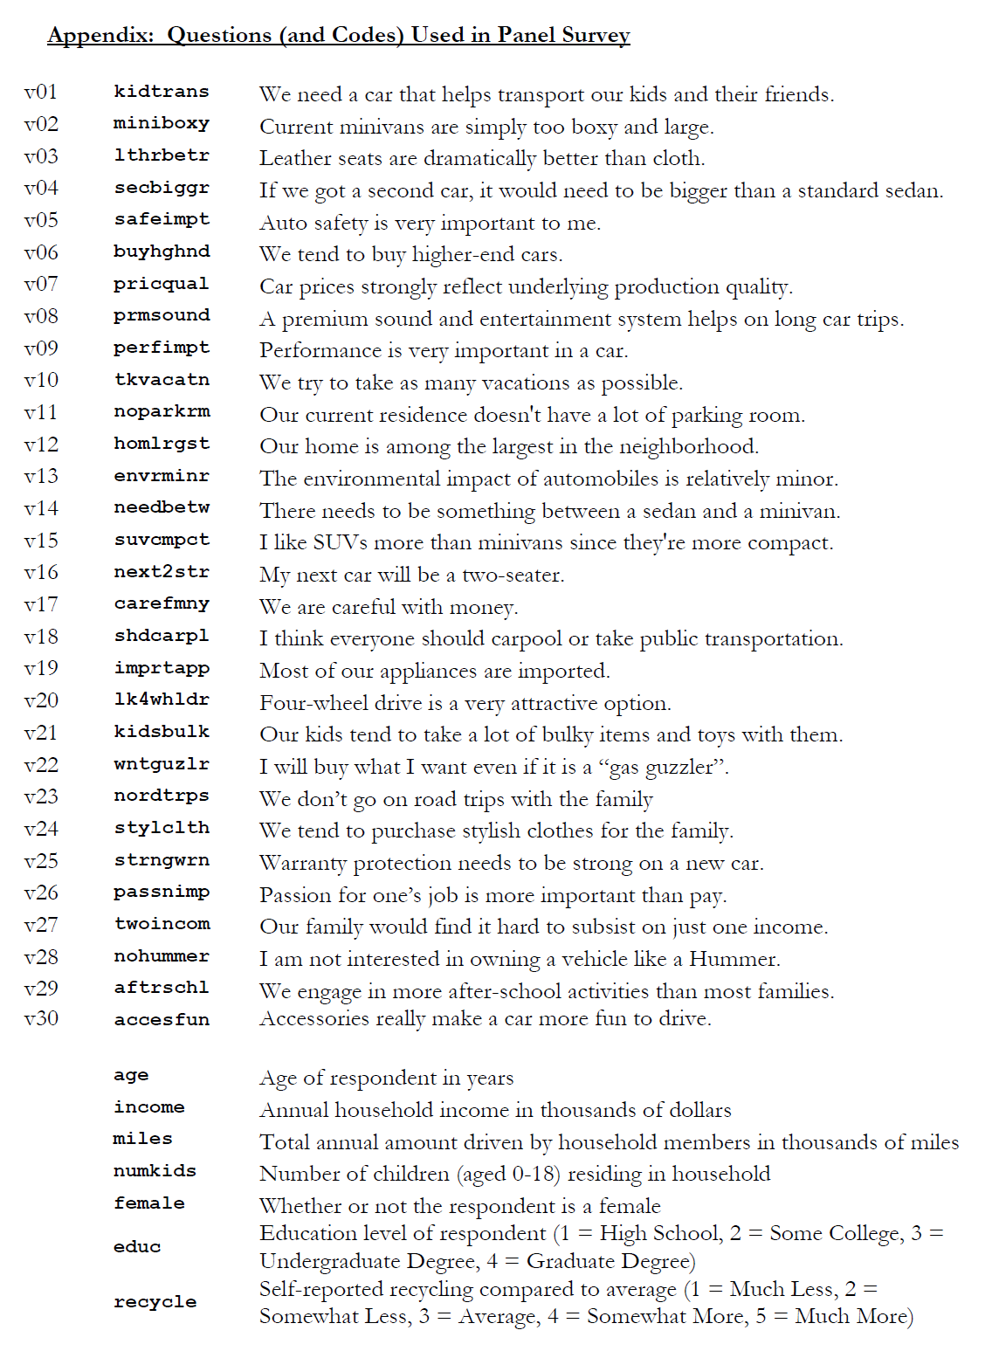
Variable Key

Slide 23
Demographic Summary Table by Clusters
 | Cluster 1 Comfortable & spacious car lovers | Cluster 2 Economical car buyers | Cluster 3 Compact & mini car lovers
Number of respondents | 114 | 157 | 129
Mean Age | 44.3 | 32.1 | 46.0
Median Income (in thousands) | 77.5 | 32.0 | 96.0
Mean annual miles driven (in thousands) | 22.3 | 14.7 | 18.4
Mean Number of Kids | 2.0 | 0.7 | 1.2
Proportion of Female | 59.7% | 49.0% | 55.0%
Median Education Level | Undergraduate Degree | Some College | Undergraduate Degree
Mean Recycling Score | 3.1 | 3.0 | 3.0

Slide 24
Focus Group Result Debrief (Survey)
We conducted a brief survey within our group:
https://docs.google.com/forms/d/1uvvMM_T7DuSWjAQ1DpZkl8kmfs6GY-SuEZWhtFJKyMQ/prefill
Main Results:
The majorities are quality conscious and economical buyers.
Budgets (in CAD): 2 responses for 25,000, 2 responses for 30,000, 2 responses for 45,000, 1 response for 55,000. Average: 36,400
Phrases frequently mentioned: “medium size” (4), care about “leg room/space” (4)
Seat number preferences range from 5 to 8. 5 is the mode.
Popular features: backup camera (6), blind sight monitoring (5), navigation system (4), sunroof (3)
Notes:
Economical buyers (4 responses)
• Average budget: 31,250 CAD
• Buying intent drop if their ideal microvan goes over their budget
Comfortable and spacious car lover (2 responses)
• Average budget: 42,500 CAD
• Buying intent do not drop as much as economical buyers if goes over their budget

Slide 25
Focus Group Debrief (Video Chat)
Link to the chat: https://drive.google.com/file/d/1y-AeHAaUUY8BflD7ogWG_PVb_OWyKyWb/view?usp=sharing
The video focus group interviewed 5 team members with questions focus on car needs in general and microvan needs and preferences specifically.
For car needs in general, most interviewees want at least one vehicle in Vancouver, and most want them to be SUV or roomy vehicles.
For microvan concept, most think the concept works in Canada, especially for families’ daily uses. Electric/hybrid microvan are preferred. Most interviewees want it to be 5 seaters and economical.
For buying intention of microvan, most interviewees want to buy one if available in Canadian market.

